Slide 1



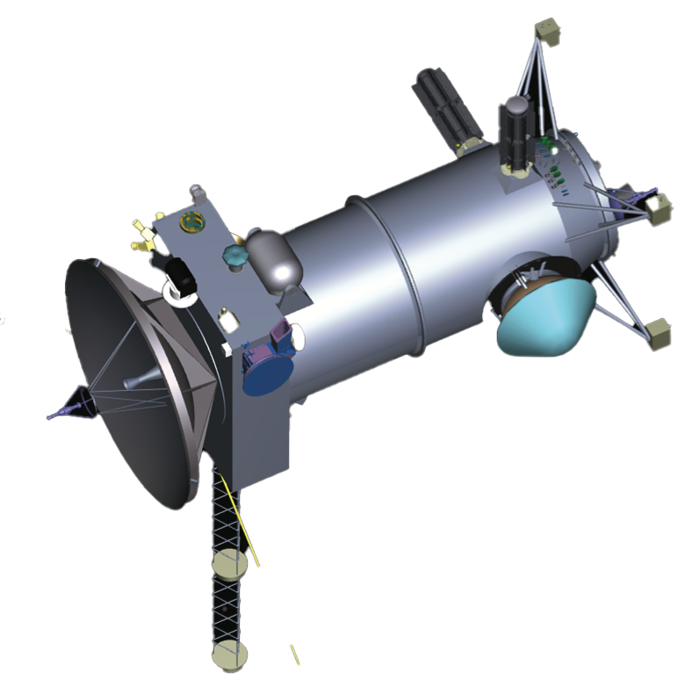
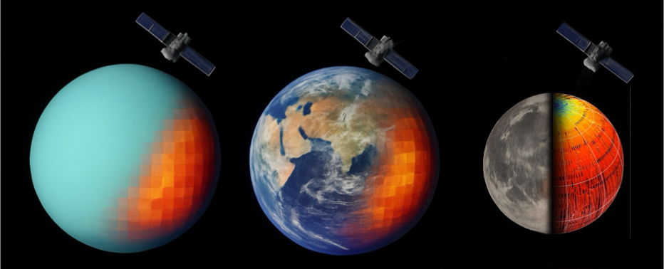
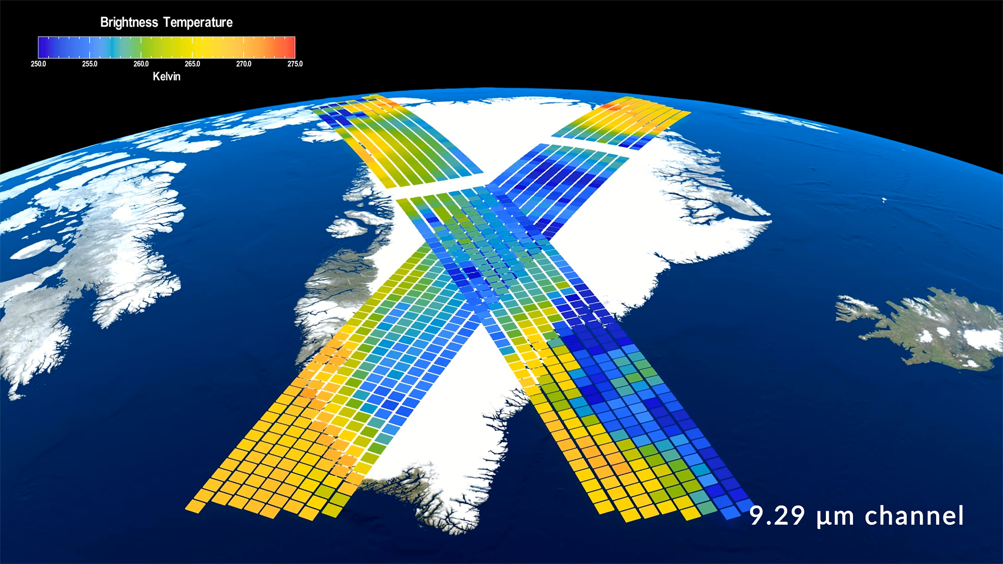
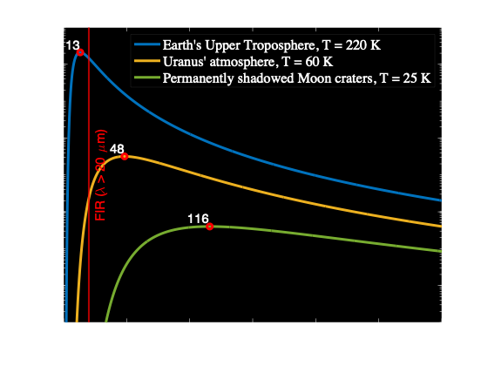
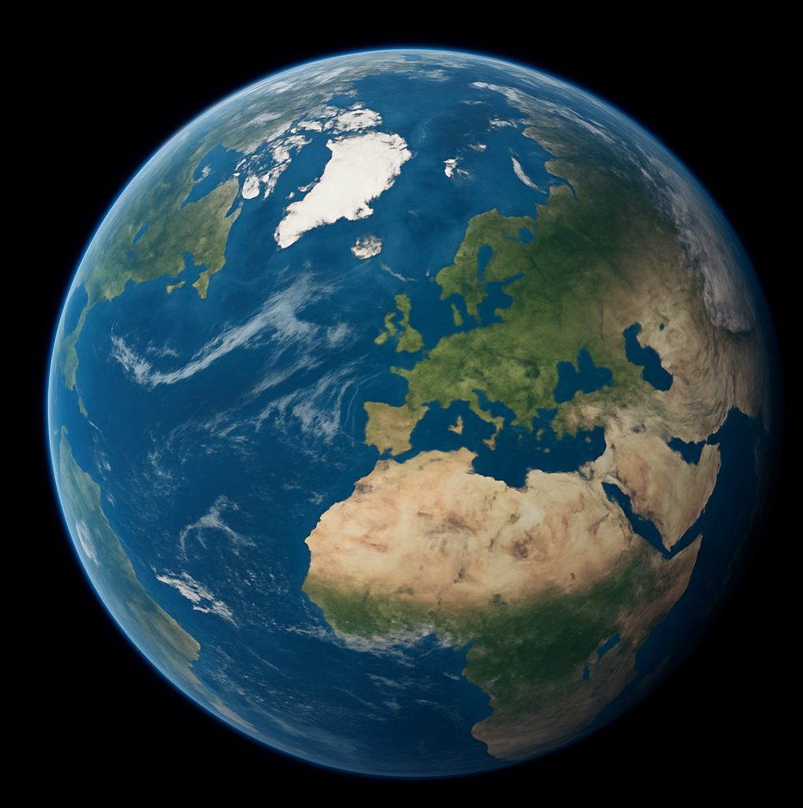
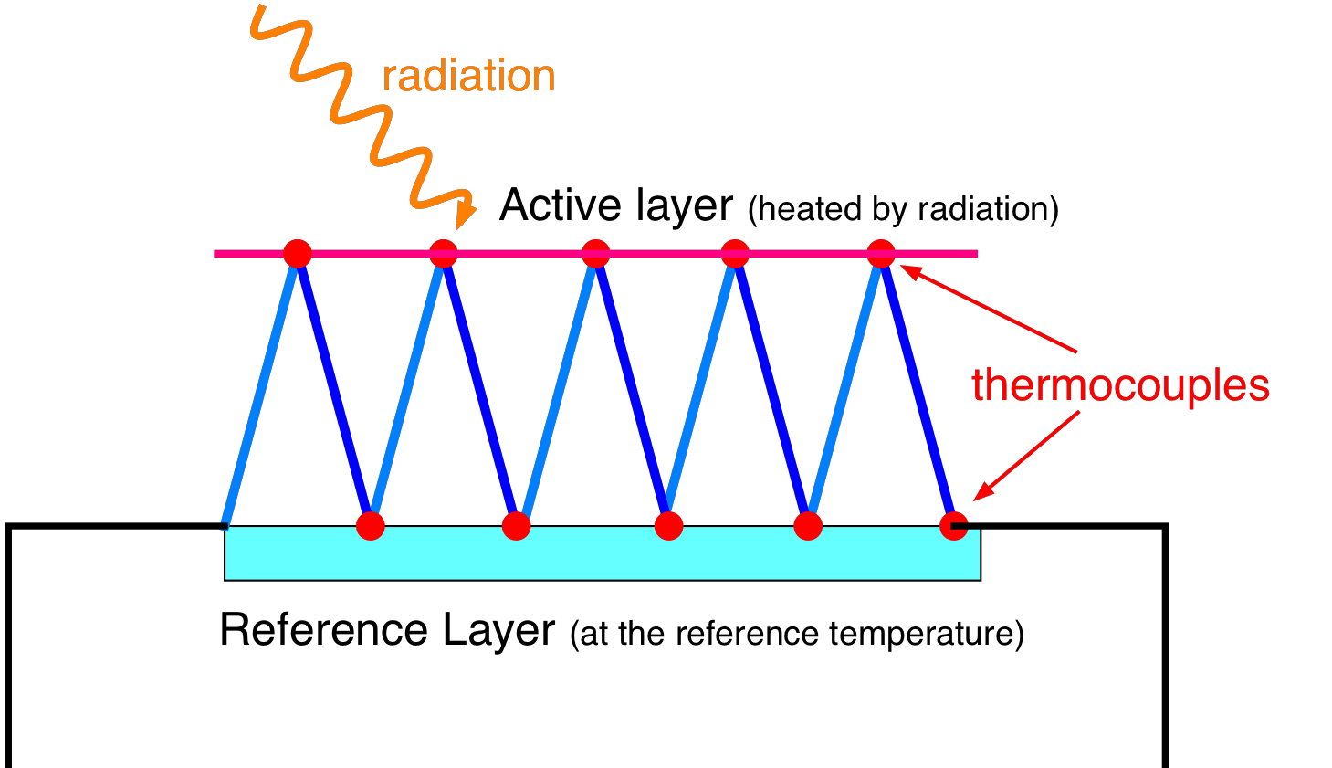
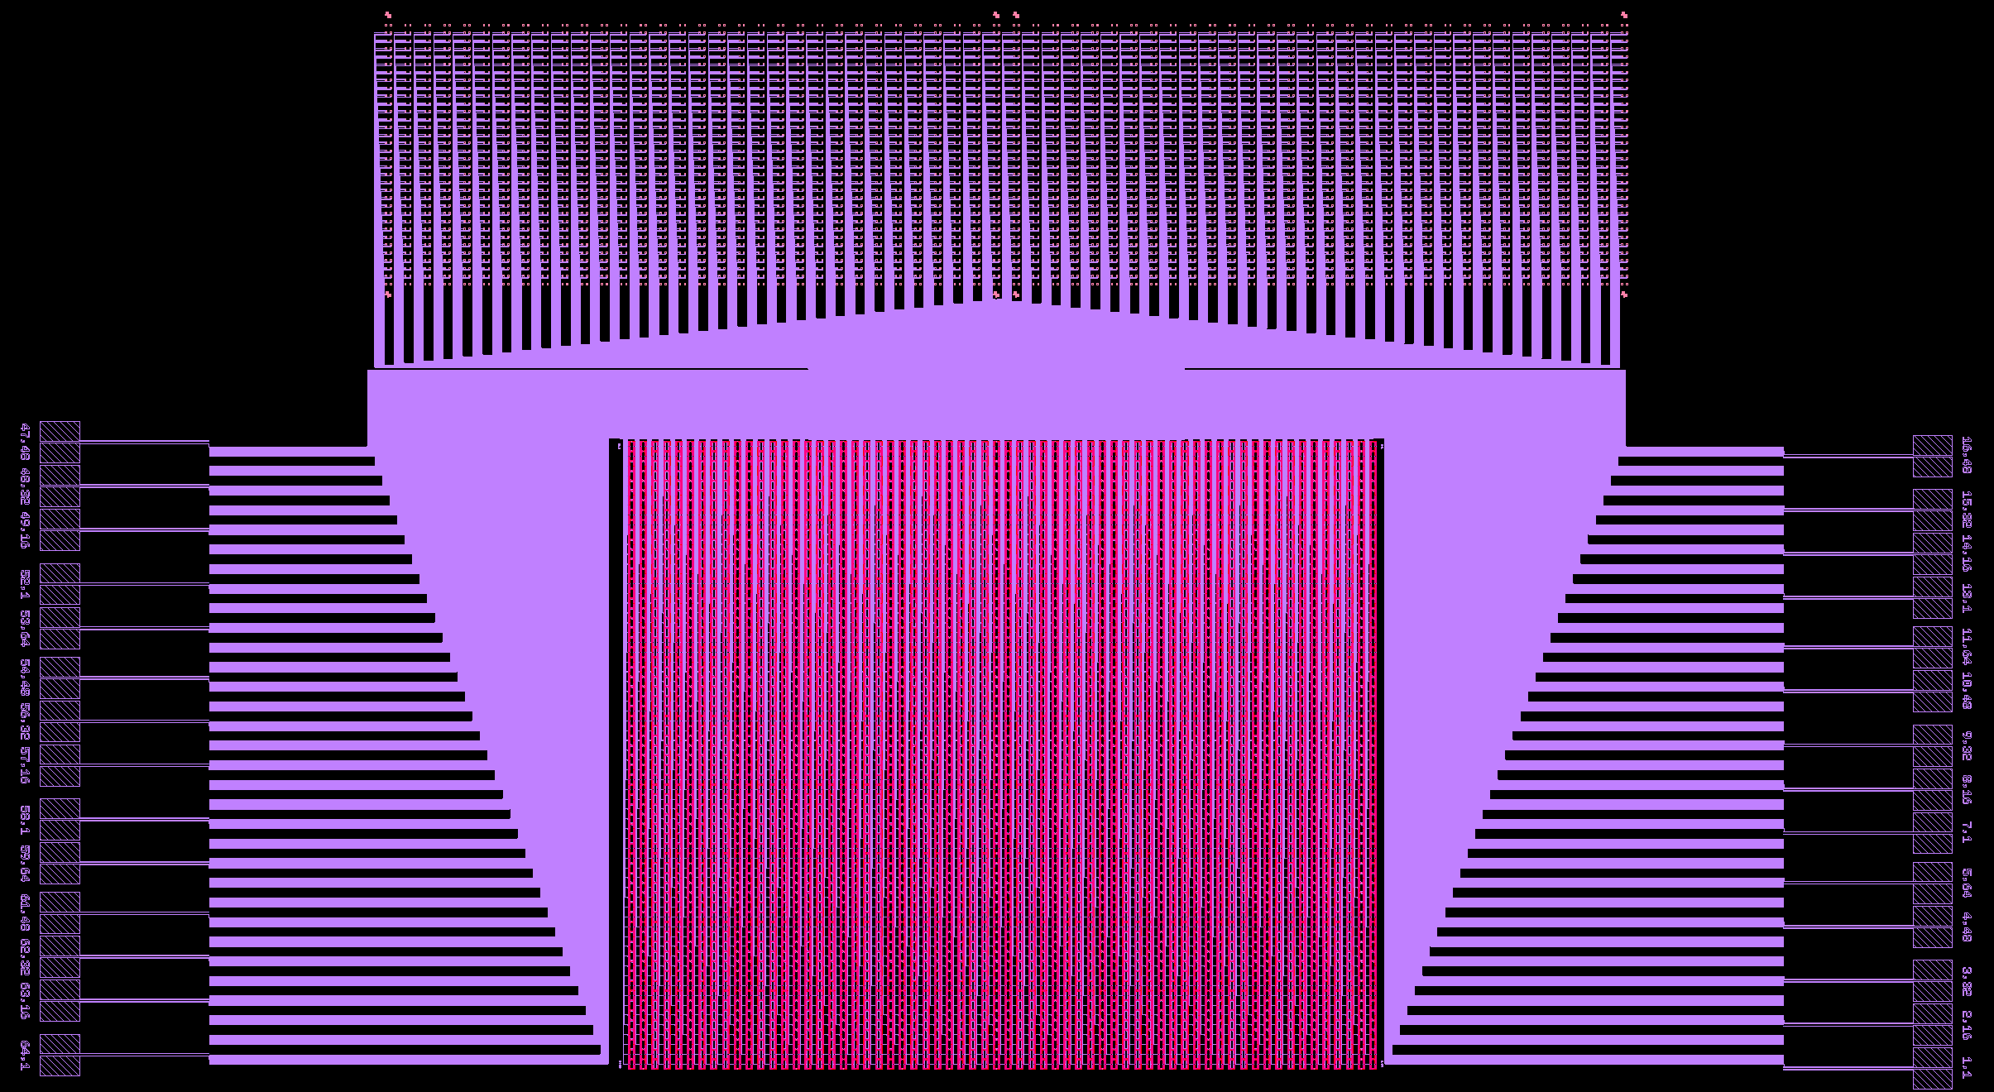
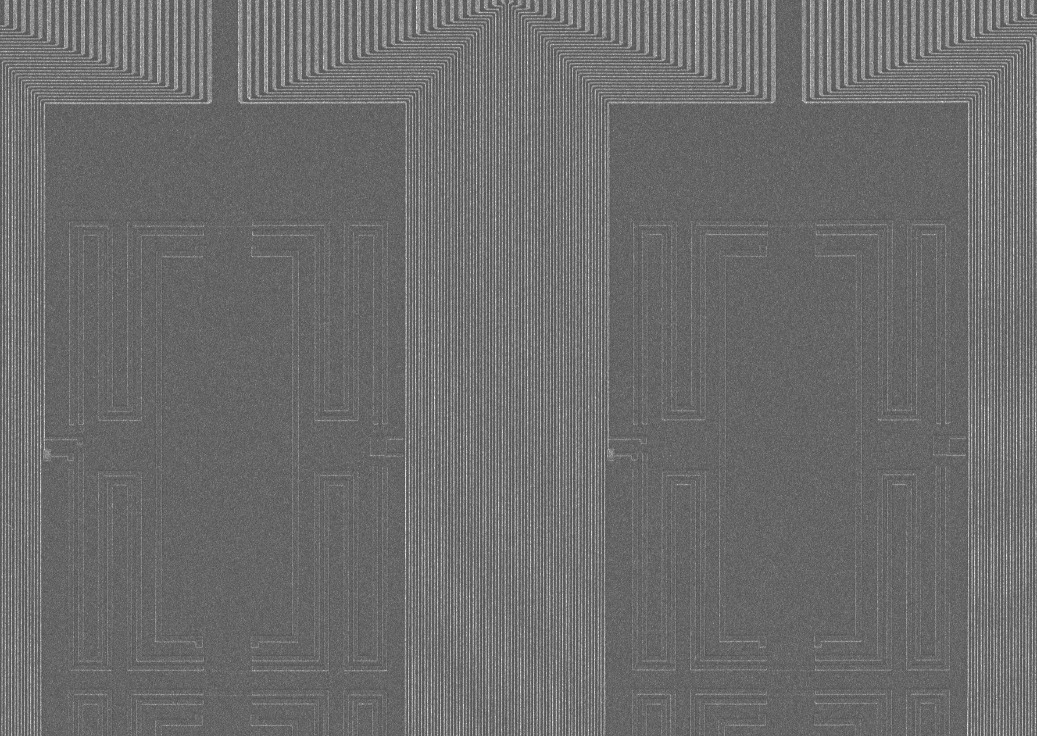
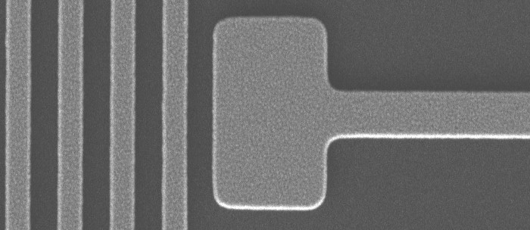
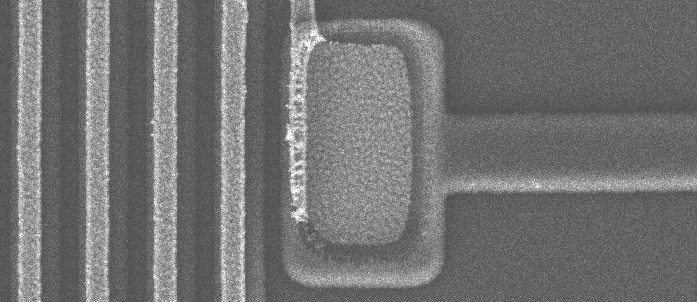
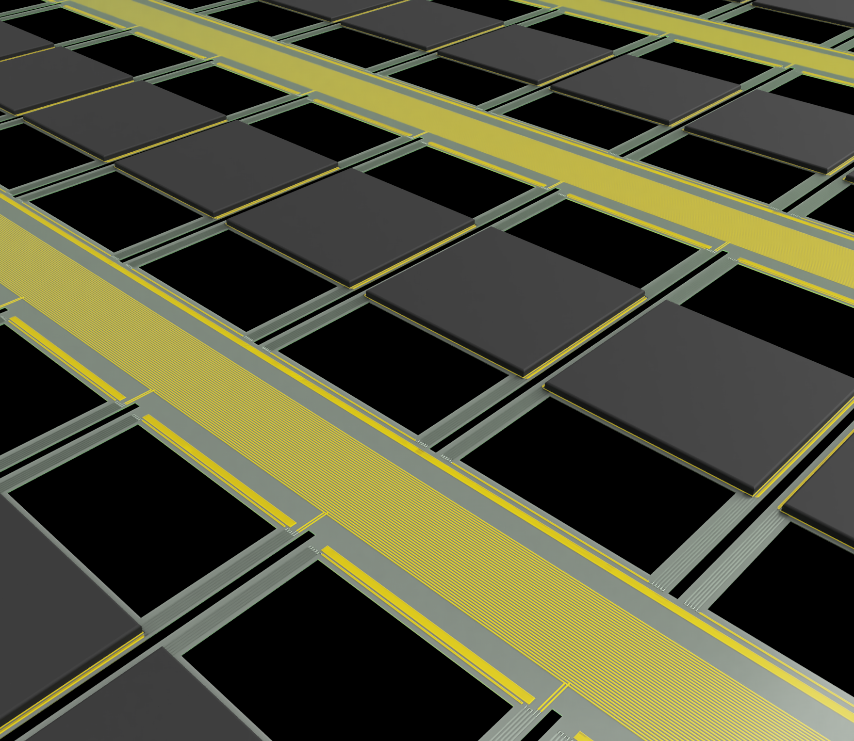
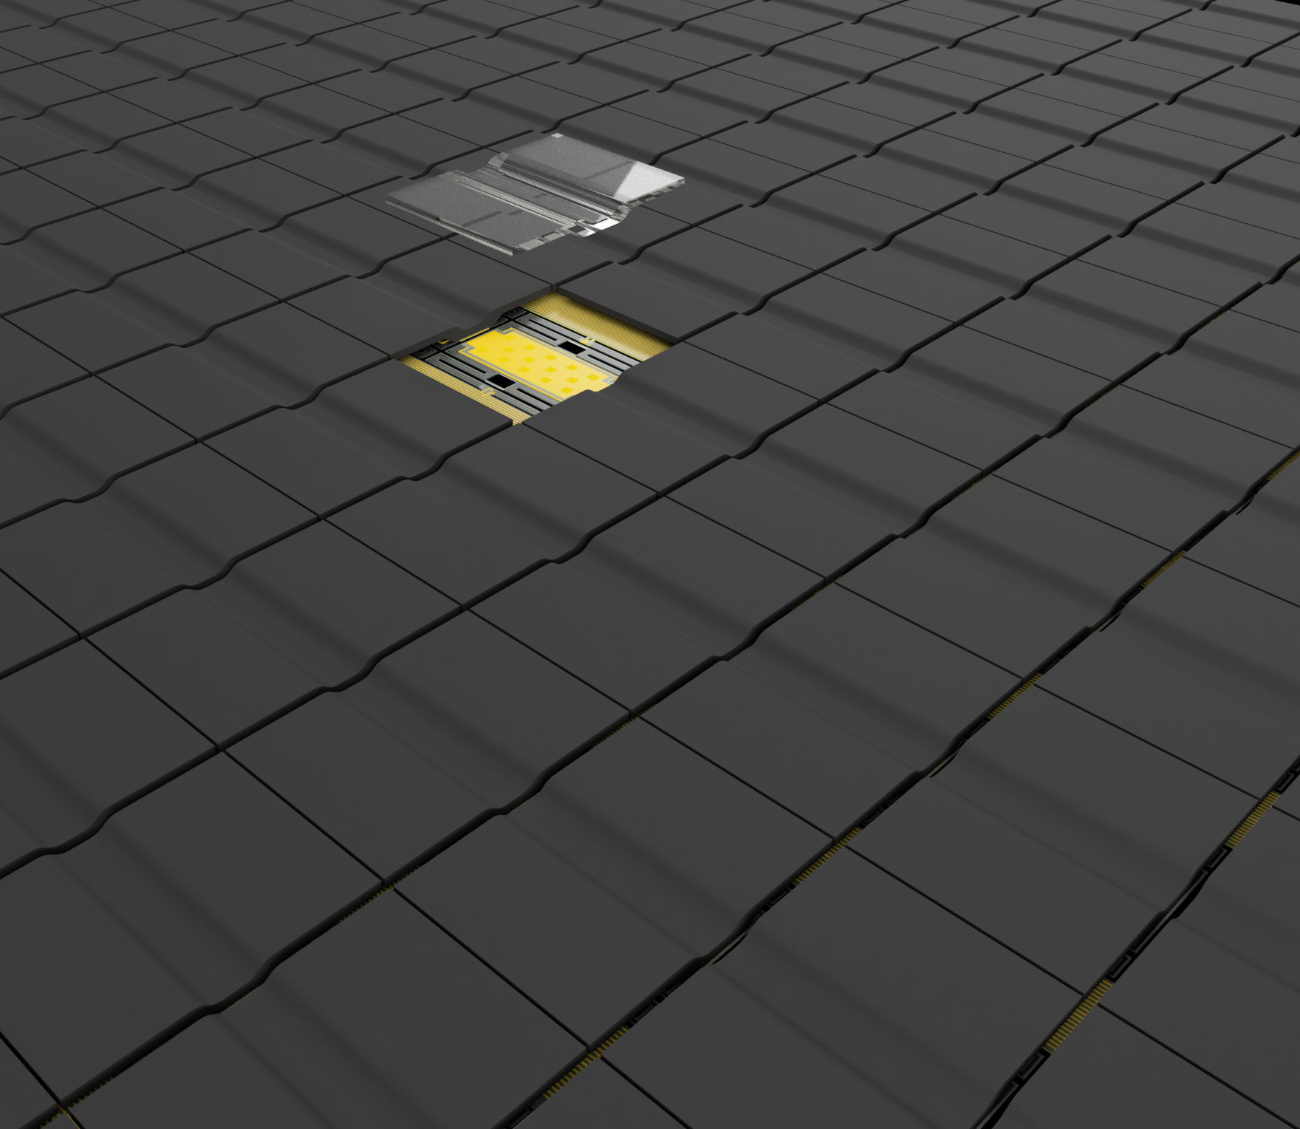
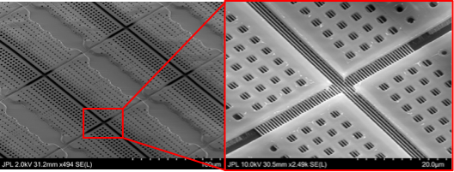
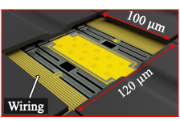











National Aeronautics and Space Administration
Postdoc Research
Next-generation Thermopile Detector Array for Far-Infrared Space-Based Remote Sensing
Author: Ricardo Braga Nogueira Branco (389I, NASA Postdoctoral Fellow)
Matthew E. Kenyon (389I)
Background
High-priority science questions can be answered by exploring the far-infrared (FIR) spectrum
$$→$$
Thermal map from PREFIRE
Thermopile detectors are uncooled thermal detectors that can perform remote-sensing (thermal imaging, spectroscopy, and energy balance) throughout the Solar System, including primitive bodies, planets, and satellites.
Learn more about PREFIRE
Learn more about Diviner
Thermal map from JPL’s Diviner on LRO
The Uranus Orbiter and Probe mission concept calls for a Diviner-like instrument
$$→$$
FIG 2: A FIR thermopile detector can perform thermal imaging and spectroscopy of the Earth, Moon, Uranus, and other bodies in the Solar System.
Incident Power, P
Image adapted from: “PLANETARY MISSION CONCEPT STUDY FOR THE 2023–2032 DECADAL SURVEY - Journey to an Ice Giant System – Uranus Orbiter and Probe”, 7 Jun 2021, https://science.nasa.gov/wp-content/uploads/2023/10/uranus-orbiter-and-probe.pdf
FIG 1: Spectral radiance of cold space bodies peak in the FIR.
Thermopiles work by converting a temperature gradient to a voltage through the Seebeck effect.
T₁
Active Layer
Key capabilities of thermopile detectors:
Broadband (0.3 to >200 $μ$m), covering full range of albedo and thermal emission.
Broad temperature range operation (>200 to <350 K).
Insensitive to instrument temperature drifts.
Negligible excess 1/f noise (long integration times).
Highly linear to incident radiation (50x more than microbolometers).
n-type: S₂
$V$ =$N∆S∆T=N∆S×P/G$
p-type: S₁
T₂
Reference Layer
Detector Sensitivity $→ D^{∗}=\frac{A^{1/2}}{S_{n}}R$
G is thermal link between T₁ & T₂
$$∆T=P/G$$
A: Pixel area $S_{n}:$ Noise $R:$ Responsivity
FIG 3: A voltage is induced across a series of N couples proportional to the Seebeck coefficient and $∆T.$
Objectives
Approach and Results
1
ROIC output
Klayout software to create the design and Python script to generate parametric wiring connections.
Deposit silicon nitride as the interlayer dielectric between wire layers and develop a process to liftoff rows of pixels for subsequent patterning.
Deposit polyimide as a sacrificial layer, pattern the structure shape, deposit silicon nitride as the absorber structure, and etch the polyimide underneath.
Use knowledge obtained from Objectives 1-3 to update design, fabricate a full 128x64 pixel array, and test the responsivity under vacuum.
Design a new detector architecture that accommodates 8,192 pixels with individual wiring connections
Develop a process to fabricate a stacked, two-layer, wiring bus to minimize the spacing between pixel rows.
Develop a process to fabricate large three dimensional ‘cantilever’ absorber structures, where the wiring and pixels sit underneath.
Fabricate and test a complete 128x64 array with the multi-tiered wiring and ‘cantilever’ absorbers.
1
Pixels
1
Wiring
2
2
1 mm
3
2
340 nm
Wire layer 1
4
State-of-the-art (PREFIRE)
64x8 pixels
~ 25% fill factor
Goal
128x64 pixels
97% fill factor
3
Wire layer 2
3
100 $μ$m
Absorber
Absorber
100 $μ$m
4
180 $μm$
180 $μm$
FIG 5: Results corresponding to Objectives 1-3.
Significance of Results/Benefits to NASA/JPL
Future Work
Complete Objectives 3 and 4 by fabricating large absorber structures with fully removed sacrificial layer and fabricating and testing a 128x64 pixel array.
Share progress through conference presentations and publications.
Wiring
FIR science throughout the Solar System: Uranus, Earth, Moon, primitive bodies, etc.
Will enable high spatial resolution thermal imager with hyperspectral capability within a small cost, size, and weight (c-SWaP) package.
3
4
Suspended Thermoelectrics
FIG 4: The next-generation detector architecture (Right) will have a larger format size, diffraction-limited pixels, and near unity fill factor when compared to the detector used in PREFIRE (Left).
National Aeronautics and Space Administration
Jet Propulsion Laboratory
California Institute of Technology
Pasadena, California
www.nasa.gov
Publications and Acknowledgements:
Eom, B. H., Pepper, B., Braga Nogueira Branco, R., Greenhagen, B. T., & Kenyon, M. E. (2025). Development of a next-generation thermopile detector for cold-body space applications. IEEE Sensors Journal, 1–9. https://doi.org/10.1109/JSEN.2025.3595487
Braga Nogueira Branco, R., H. Eom, B., Pepper, B., & E. Kenyon, M. (2025). Fabrication of Cantilever Absorber Structures for Enhanced Performance of Space-Based Far-Infrared Thermopile Detectors. 2025 50th International Conference on Infrared, Millimeter, and Terahertz Waves (IRMMW-THz).
Braga Nogueira Branco, R., H. Eom, B., Pepper, B., & E. Kenyon, M. (2025). Development of a high-fill-factor thermopile array for space-borne far-infrared radiometry. 2025 SPIE Sensors + Imaging Conference.
Braga Nogueira Branco, R., H. Eom, B., Pepper, B., & E. Kenyon, M. (2026). Progress Towards a Near-Unity Fill Factor FIR Thermopile Detector for Space-Based Remote Sensing. 2026 IEEE Aerospace Conference (Under review)
Author Contact Information: rbranco@jpl.nasa.gov
Clearance Number: CL#00-0000
Poster Number: Postdoc-T-006
Copyright 2025. All rights reserved.

